Slide 1
BA Training Day 6

Slide 2

Review of Day 5
Business Process Models
BPMN
UML
Wireframe
Wireframe vs Mockup vs Prototype
Use Case
RTM

Slide 3
Business Process Models
A method of visually documenting the stages involved in performing a certain business procedure.
Relies on conventions like Business Process Model and Notation (BPMN) or Unified Modeling Language (UML) to set up models or simulations of a business process for evaluation and possible alteration.
Typically, an activity is viewed as a workflow or process composed of events, activities, gateways and (sometimes) other elements.

Slide 4
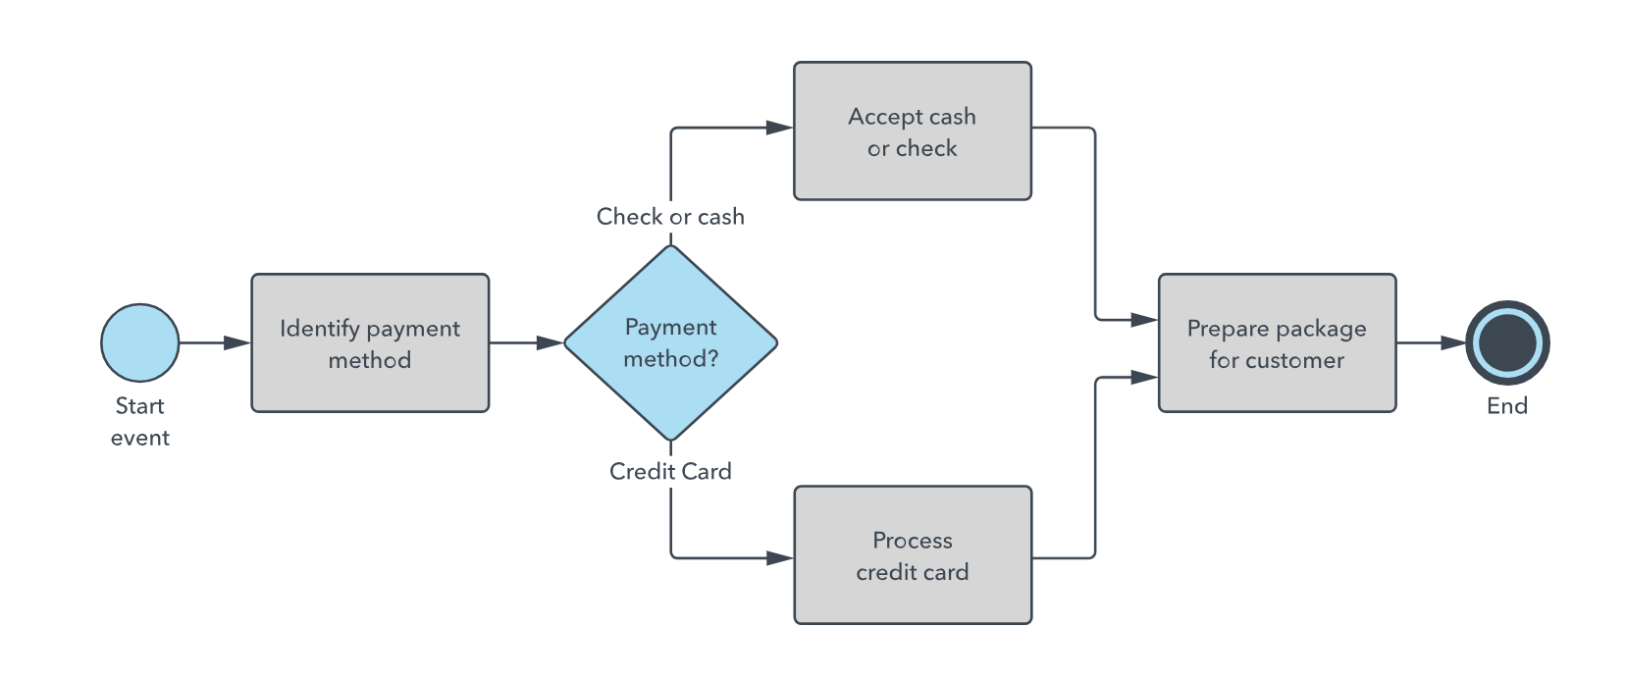
Business Process Model Notation
Business Process Modeling Notation (BPMN) is a method of illustrating business processes in the form of a diagram similar to a flowchart.
It is a flow chart method that models the steps of a planned business process from end to end.
At a high level, BPMN is targeted at participants and other stakeholders in a business process to gain understanding through an easy-to-understand visual representation of the steps

Slide 5
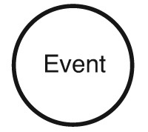
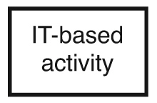
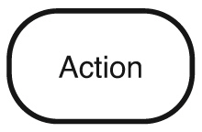
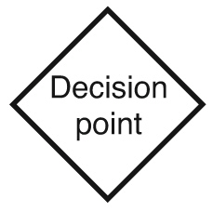
Notations
Event - an action or IT-based activity from an external source or carried out by the customer.
IT-based activity - documentation, sending or requesting information, for example)
Action - to be carried out by a person in the organization.
Decision point or Gateway - where a decision has to be made and the flow can go more than one way.

Slide 6
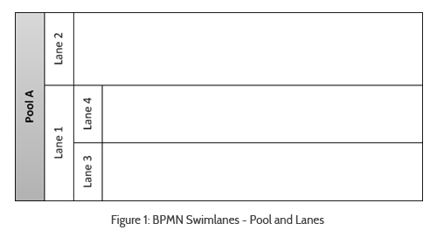
Swimlanes
A swimlane is an element that allows distinguishing participants and responsibilities in a business process diagram.
Makes it possible to organize the diagram in activities, in order to display different functional capacities or organizational roles.
2 types: Pools & Lanes

Slide 7
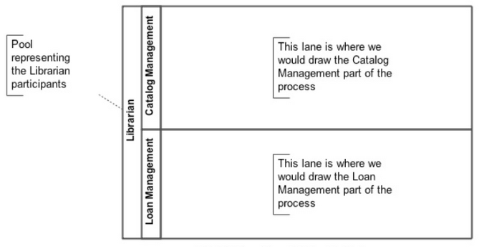
Pool
Represent containers of a process, where each one of them is the process in a participant and is used when the diagram involves two or more business entities or separate participants.
Activities within containers are considered as independent processes.
Therefore, in the message flow they are defined as the mechanism for communication between two participants.

Slide 8
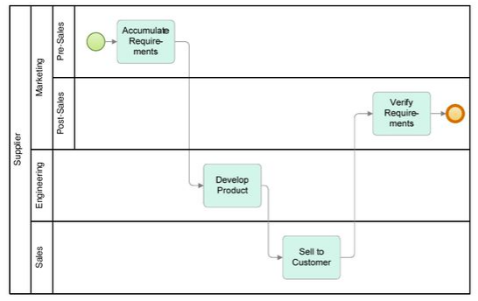
Lanes
They make it possible to associate activities with a specific function or role in a company. Lanes represent various process activities, for a participant in particular.
Lanes are divisions within pools, and they can be vertical or horizontal.

Slide 9
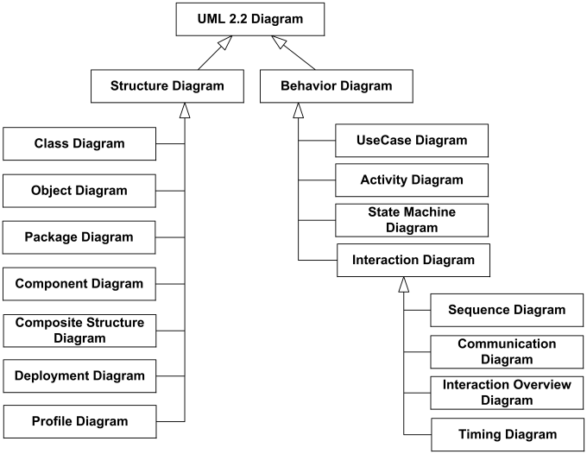
Unified Modeling Language (UML)
UML is a standardized modeling language enabling developers to specify, visualize, construct and document artifacts of a software system.
It uses graphic notation to create visual models of software systems.
UML diagramming was created: to forge a common visual language in the complex world of software development that would also be understandable for business users and anyone who wants to understand a system.

Slide 10
Wireframe
A Web wireframe is a simple visual guide to show you what a Web page would look like.
It suggests the structure of a page, without using any graphics or text.
A website wireframe would show the entire site structure - including what pages link to where.
Web wireframes are a great way to start your design work.
The key to making good wireframes is to leave out all visual elements. Use boxes and lines to represent pictures and text.
Things to include in a Web page wireframe:
boxes for primary graphical elements
placement of headlines and sub-heads
simple layout structure
calls to action
text blocks

Slide 11
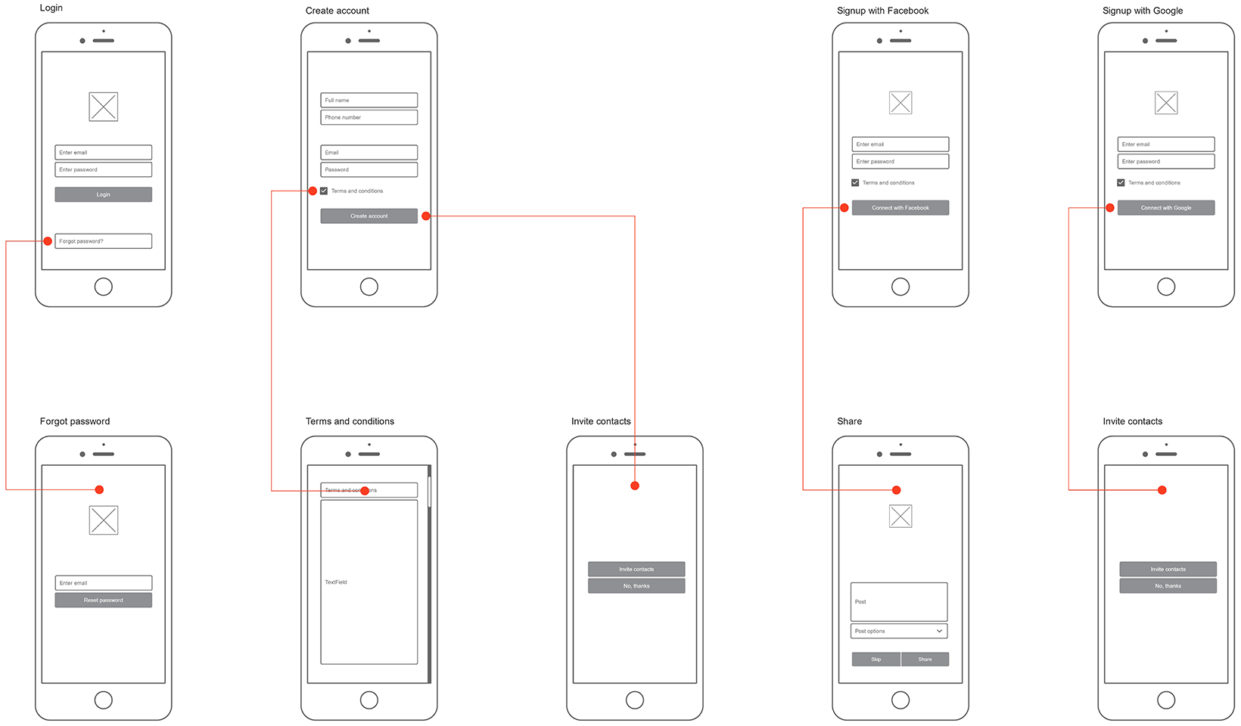

Slide 12
Wireframes Vs Mockup Vs Prototype
Wireframe, a low-fidelity way to present a product, can efficiently outline structures and layouts. Wireframe is the basic and visual representation of the design. Your wireframe design doesn’t need to focus too much on details but must express design ideas and should not miss any important parts. A wireframe is like a channel that helps team member understand their projects better.
Mockup, a kind of high-fidelity static design diagram, should demonstrate information frames and statically present content and functions. Unlike a wireframe, a mockup looks more like a finished product or prototype, but it is not interactive and not clickable. It is rather a graphic representation. This can be helpful, for example, to provide investors with a picture of how a finished product can be and help team members review their project visually.
Prototype is already very close to the finished product. Here, processes can be simulated, and user interaction can be tested. A prototype looks very similar to the finished product. Early prototyping can save a lot of development costs and time so that the work of back-end product architecture will not be in vain because of unreasonable user interface design. A prototype is an excellent tool to obtain user feedback and to test the product.

Slide 13
Use Case
A use case diagram is a graphic depiction of the interactions among the elements of a system.
Use cases define interactions between external actors and the system to attain particular goals.
There are three basic elements that make up a use case:
Actors: Actors are the type of users that interact with the system.
System: Use cases capture functional requirements that specify the intended behavior of the system.
Goals: Use cases are typically initiated by a user to fulfill goals describing the activities and variants involved in attaining the goal.

Slide 14
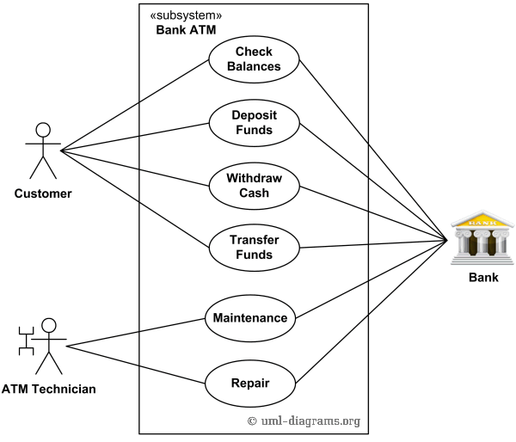
Example
An automated teller machine (ATM) is a banking subsystem that provides bank customers with access to financial transactions in a public space without the need for a cashier, clerk, or bank teller.
Customer uses bank ATM to Check Balances of his/her bank accounts, Deposit Funds, Withdraw Cash and/or Transfer Funds.
ATM Technician provides Maintenance and Repairs.
All these use cases also involve Bank actor whether it is related to customer transactions or to the ATM servicing.

Slide 15
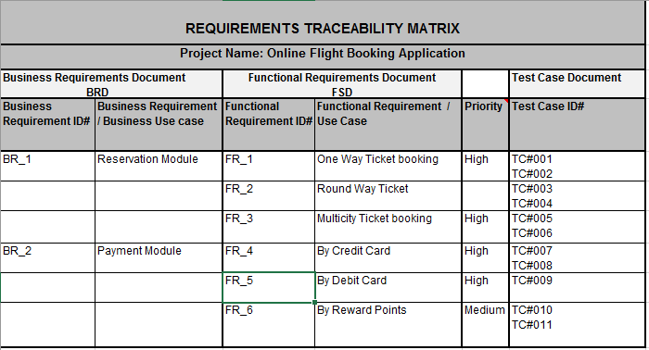
Requirements Traceability Matrix (RTM)
A matrix used to track requirements' relationships. Each column in the matrix provides requirements information and associated project or software development components.
It is a document that links requirements throughout the validation process. The purpose of the Requirements Traceability Matrix is to ensure that all requirements defined for a system are tested in the test protocols.

Slide 16


